Slide 1


Team 14: Perfect Pour Over Coffee
Bi-Weekly Update 1 Mark Golla, Cindy Ho, Zeeshan Virani Sponsor: Stavros Kalafatis TA: Eric Robles
Notes:
Intro should take 30 seconds

Slide 2
Problem Statement:
Issues pertain to human errors & inconsistencies with pouring methods
Current method is very tedious and imprecise
Our Coffee System will:
Focus on automating the process by utilizing machine learning & built-in sensors to regulate temperature & water saturation levels
Create the perfect cup of coffee for each user by tailoring user preferences of roast type through an android app & machine learning

Slide 3
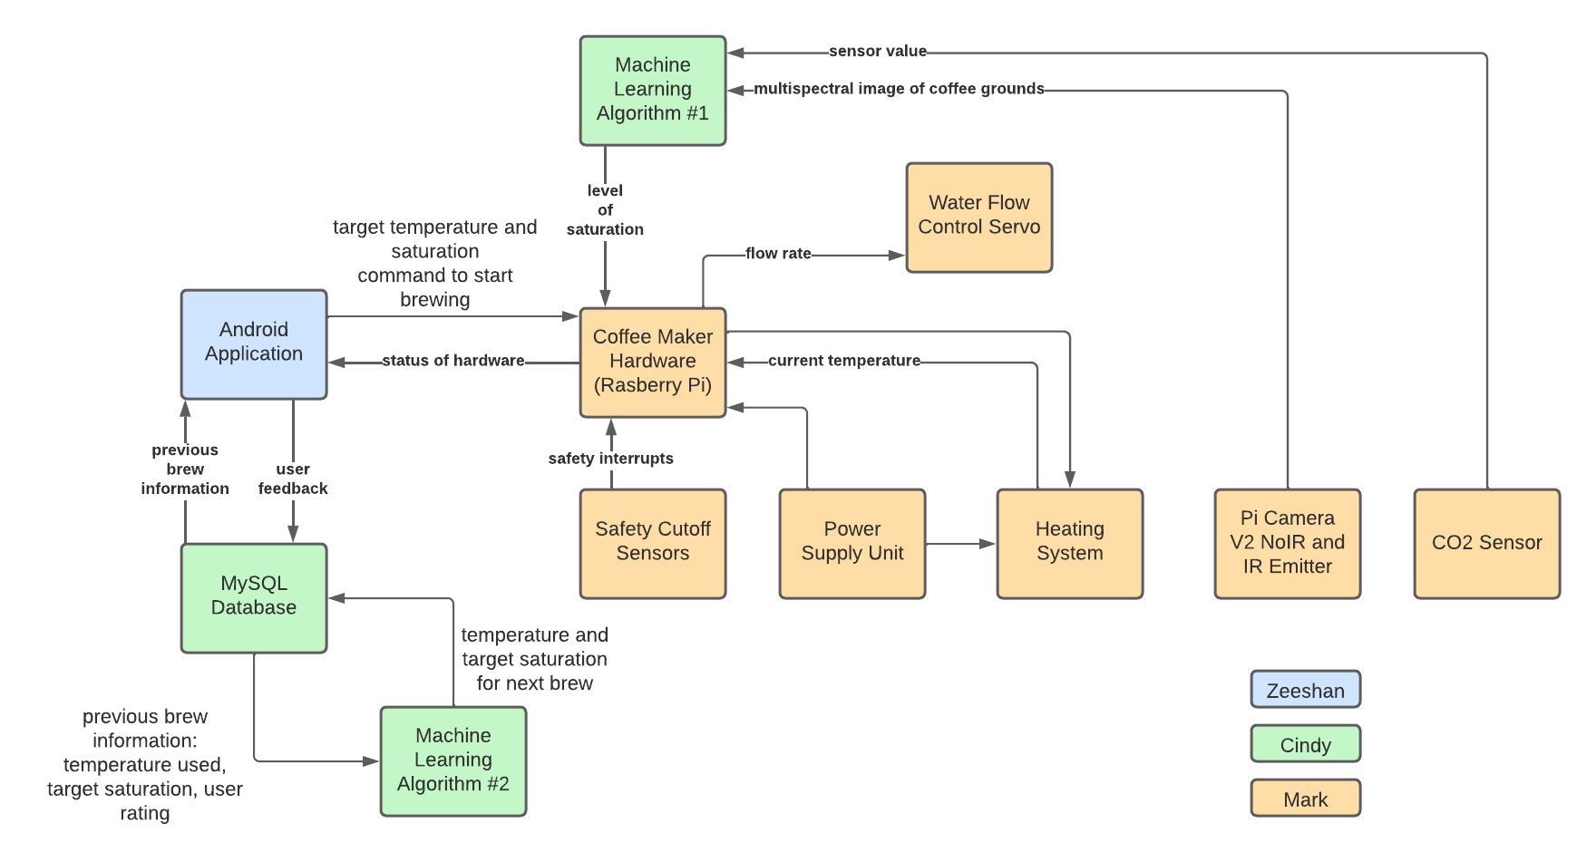
System Overview

Slide 4
Project Timeline
Testing of individual subsystems
Gather data for algorithms
Create communication layer between Android app and Hardware
Integrate database into Android App and Hardware
Test complete
system
Fix bugs and errors
Final testing
Notes:
Eric

Slide 5
Hardware / Peripherals Subsystem
Accomplishments since the last presentation | Plans for 404
Validation of Heating Finalization of Water Distribution Validation of Carafe Detection Started work on sensor hub PCB Skeleton for mounting of necessary components Co2 Testing Stepper Motor Control with Pi | Integration of Physical User Interface App Controlled start and true integration of error reporting and progress Finalized Housing/Mounting Assembly of sensor hub PCB

Slide 6
Machine Learning & Database Overview
Accomplishments since 403 | Ongoing progress/problems and plans until the next presentation
Water Saturation Prediction Created 7000 images for dataset utilizing multispectral imaging camera Trained & Validated CNN model User Feedback Prediction Created dataset of 200 samples RF Classifier & KNN Model Database Storage Capacity: 1 GiB Established connection between database & user feedback prediction | Utilize system to generate new image dataset to test both models Continue testing & validating both models Reorganize database & validate connection to other subsystems

Slide 7
Android Application
Accomplishments from 403 | Plans for 404
Fully functional app GUI Firebase authentication for user login and management Integrated Firestore as database for storing brewing history and user data Validated Bluetooth Connection between Device and Raspberry Pi | Handle data sending and receiving from hardware subsystem Setup background notifications for brewing status Update information on Support page

Slide 8
Parts Ordering Status
Part | Status
Raspberry Pi, Picam V.2, Smartphone | Received
Coffee for testing, LEDs, CO2 Sensor, Proximity Sensors | Received
Carafe/Filter | Received
Water Distribution System Components (Sheet metal, fasteners, compression spring, stepper, stepper driver) | Received
Water Heating System Components (Heating Element, SSR, high current cable) | Received
Parts for Mechanical Design (ABS printer filament, sheet metal, mineral wool insulation, stainless steel reservoir, silicone sealant) | Received
Notes:
Michelle

Slide 9
Execution Status
Date | Cindy | Mark | Zeeshan | Status
09/08/22 | - Increase accuracy of user preferences algorithm & look into reinforcement learning | - Finish fixing leak through valve installation - Camera mounting for new training data - Adding threading to control system | - Testing of bluetooth connectivity | In Progress
09/15/22 | - Assist with new training data collection - Continue collecting new training data | - Assist with new training data collection - Continue collecting new training data | - Implement background capabilities for bluetooth system | Not Started
09/22/22 | - Integrate ML onto HW | - Working on housing - Hosting app interface on actual hardware | - Implement background capabilities for bluetooth system | Not Started
09/29/22 | - Integrate ML onto HW - Integrate Database with HW | - Working on housing - Hosting app interface on actual hardware | - Data handling between Pi and Android device | Not Started
10/06/22 | - Integrate Database with HW | - Validate app integration | - Data handling between Pi and Android device | Not Started

Slide 10
Execution Status Continued
Date | Cindy | Mark | Zeeshan | Status
10/13/22 | - Validate integration between ML & HW - Validate integration between Database & HW | - Data handling between Pi and Android device | - Data handling between Pi and Android device | Not Started
10/20/22 | - Continue validation | - Continue validation | - Implement notification system | Not Started
10/27/22 | - Continue validation | - Continue validation | - Add data to support page | Not Started
11/3/22 | - Continue validation | - Continue validation | - Testing of integrated system | Not Started
11/10/22 | - Continue validation | - Continue validation | - Testing of integrated system | Not Started

Slide 11
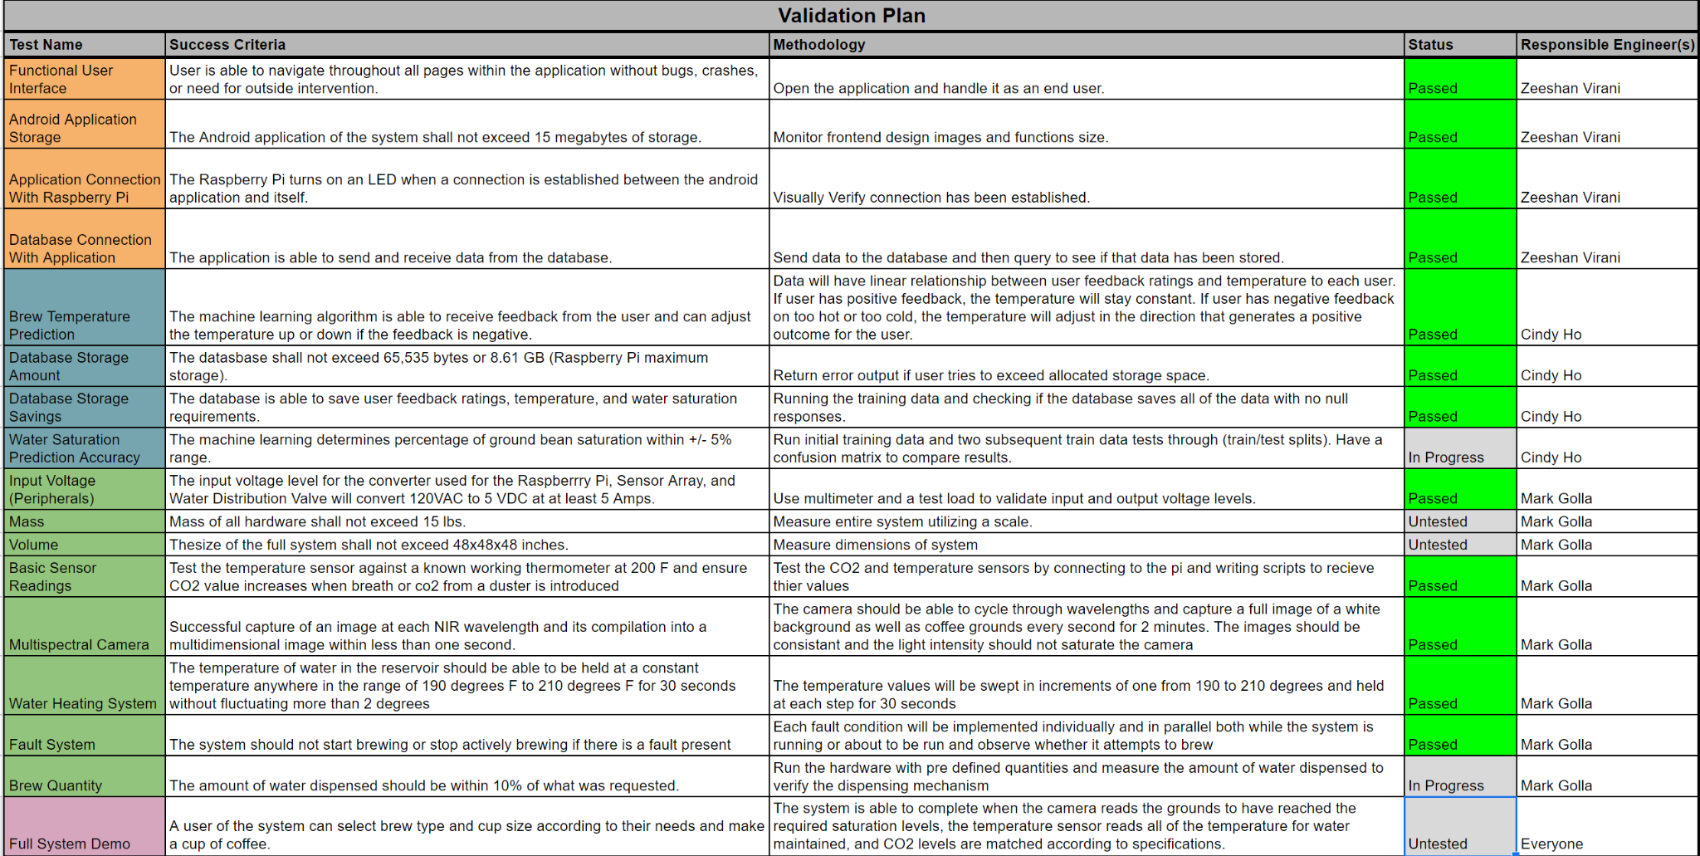
Validation Status

Slide 12
Thank You

